Slide 1
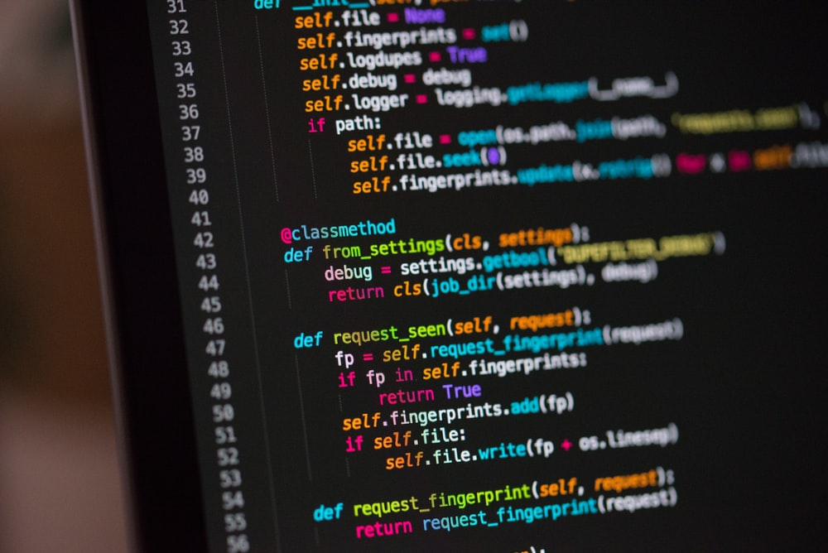
Predicting programming language from code snippet ideathon
By: ahmed al-baz (tcs Canada)

Slide 2
REQUIREMENTS
A logical machine learning model to represent the code segment
Innovative methods and processes to build this model (scanning technique, representing the code as vectors)
The model and the techniques should work well for every programming language (Should be language independent)
It should cover at least 25 programming languages (C, C++, Java, Python, VB, PB, ASP, JSP, Typescript, COBOL, Natural, PL1, JCL etc)
A simple implementation prototype with results (Optional, no need to share the implementation code but share only the results)
END OUTCOME
A detail documented process to implement this solution.
Assumptions
Training data can be picked up from any open-source code repository

Slide 3
Workflow
DATA COLLECTION
DATA PROCESSING
MODEL BUILDING
MODEL VALIDATION
IMPLEMENTATION

Slide 4
Data COLLECTION
The code snippets were web-scraped from the Rosetta Code webpage using a Python script
The Python script mainly relies on the BeautifulSoup library – a common web-scraping library
Rosetta Code is a wiki project created by Mike Mol in 2007 that solves common tasks in a myriad of coding languages. As such, it is a useful resource to obtain code snippets with their labels. Link: www.rosettacode.org
The scraper crawls across each task page and writes the name of the language and its corresponding code snippets for that given task to a CSV file
The scraper using multi-processing to speed up scraping
Around 30,000 code snippets, spanning 30 languages, were obtained
The scraped languages are:
Ada, AWK, C, C++, C#, COBOL, Fortran, Go, Groovy, Haskell, Java, JavaScript, Julia, Kotlin, Mathematica, MATLAB, Perl, PHP, PowerShell, PureBasic, Python, R, Racket, Ruby, Rust, Scala, SQL PL, Swift, UNIX Shell, VBA

Slide 5

Data processing
The goal of this step is to convert data from string format to a numeric representation that can be understood by the machine.
The Python Pandas library was used to load the scraped data from the CSV file to a DataFrame object. This loads the data into a tabular format with 2 columns one containing a string for the name of the programming language and the other containing the string for the code snippets
Each of the programming languages were mapped/encoded to a unique numeric representation from 0-29
(i.e Ada → 0, AWK → 1, C → 2, …, VBA → 29)
The code snippets were preprocessed to remove characters that were non-English (a-zA-Z), non-numeric (0-9), not a space(‘ ‘) or end-line(‘\n’), and not a punctuation/symbol (!@#$%^&*()[]{}:;.?/\,+-=)
The case-sensitivity of each snippet was preserved since it could be a distinguishing factor among languages

Slide 6
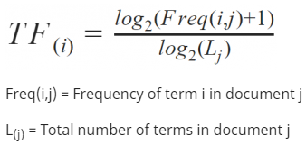
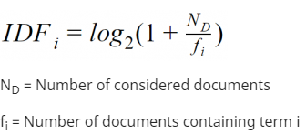
Data processing – ConTinueD
Next, the processed code snippet was split into tokens – substrings that will be used as the features for the machine learning model
Creating tokens was done on a mixed-level (both words and characters)
Word-level: Any word that is surrounded by a punctuation and/or a space was made into a token
Character-level: Any punctuation mark /symbol was also made into its own token
The tokens were then converted into a vector based on the product of their term frequency (TF) and inverse document frequency (IDF) using Python’s sklearn library
This scores each token in a weighted manner based on how often they appear scaled by their appearance across all snippets
Words like “the” which appear frequently in all snippets will be weighted less than words that more unique to each snippet
More than 70,000 unique tokens were generated from all the snippets combined
***formulas from www.serobility.net/en/wiki/TF*IDF

Slide 7


Data processing – SUMMARY
***These processing steps can be applied to any language (language-independent)
def
HelloWorld
(
)
:
\n
Print
(
‘Hello
World
’
)
def HelloWorld():
print(‘Hello World’)
Sparse vector of shape (1, ~70000) containing the TF-IDF scores of each of the ~70,000 tokens for the given code snippet
Processing
+ Tokenization
List of tokens for snippet
Vector Representation of Snippet
Original Snippet
TF-IDF Vectorizer

Slide 8

MODEL BUILDING
When referring to features, the intended meaning is the TF-IDF score for each of the 70,000+ tokens
When referring to class, target or target class, the intended meaning is the programming language to be predicted
The model is built using Scikit-Learn library in Python
The chosen model is a Support-Vector-Machine (SVM) Classifier with a linear kernel
The SVM was chosen since this problem deals with a high feature space (>70,000 unique tokens in the dataset) and linear SVM's are known to excel in this application which is often the case with natural language processing applications.
SVM’s work by finding a hyperplanes (high-dimensional plane) that achieve the maximum degree of separation for the different classes (programming languages) given the feature space
Given an n-dimensional space, the hyperplane of separation is of dimension n-1
The scraped data is split into 2 sets:
80% forms a training set
20% forms a validation set to check the results of the model on unseen data

Slide 9
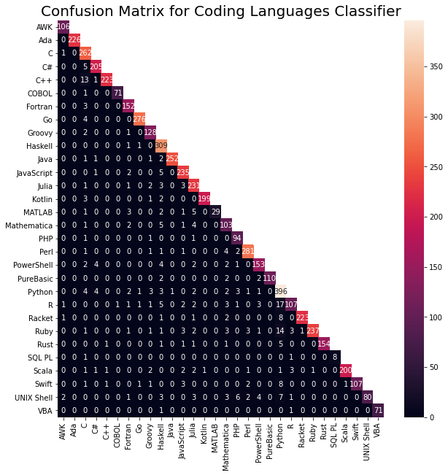
MODEL Validation
After fitting the model on the training set, the model was evaluated on the validation set
Training accuracy: 97.44%
Validation accuracy: 89.54%
A confusion matrix was generated for each the predictions on the testing data and is displayed
Figure: The confusion matrix compares model’s predicted class (X-axis) versus the ground-truth class (Y-axis). The diagonal indicates the number of correctly-made predictions, in this case, most are correct

Slide 10
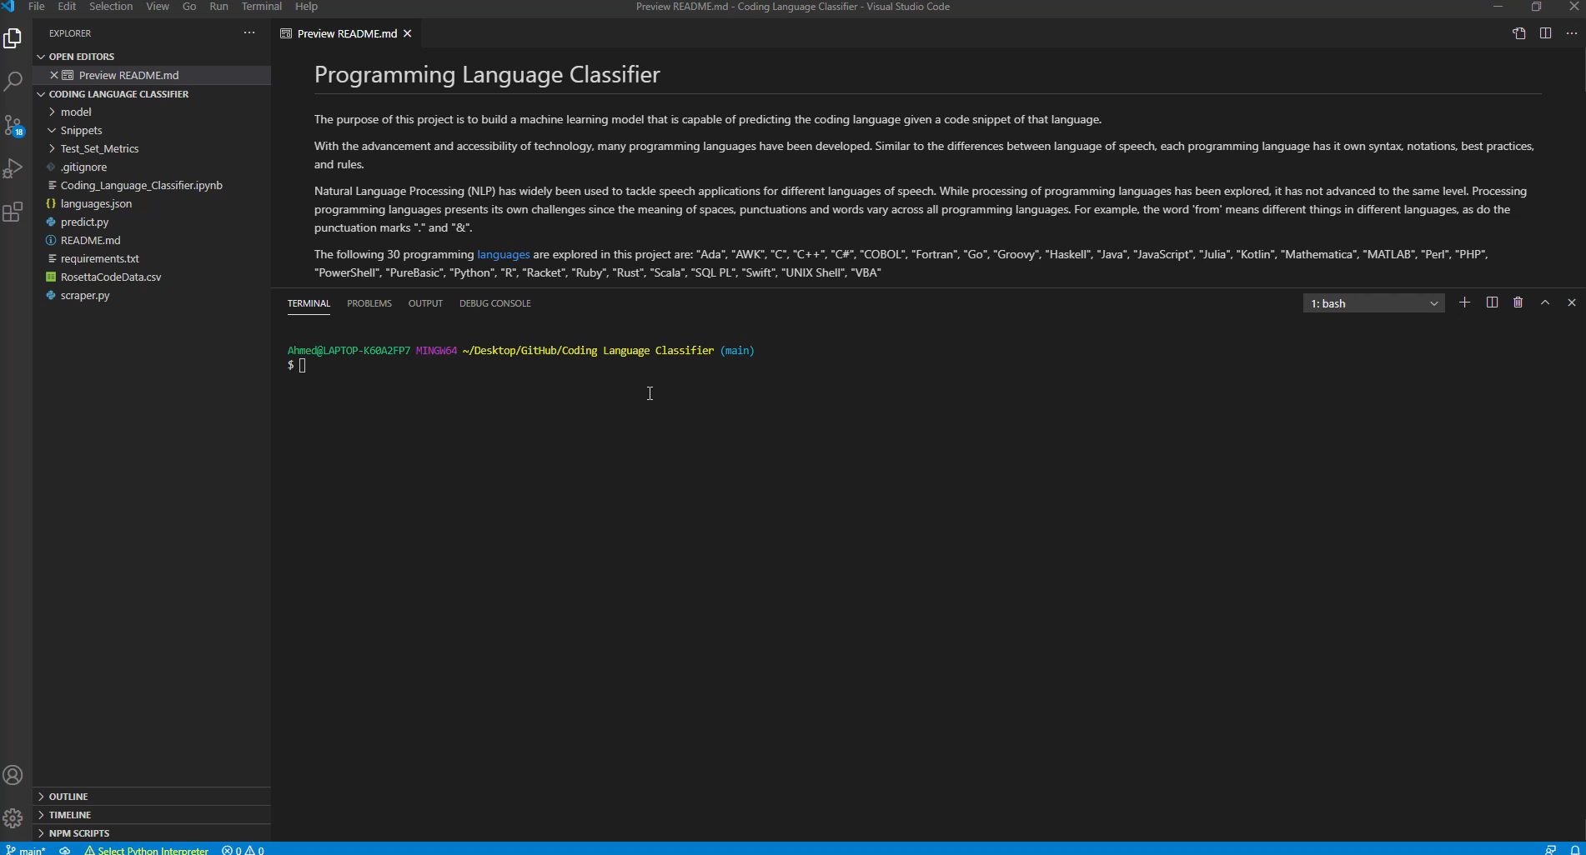
Implementation
The following is a brief video demonstration of the model prototype:
Full code can be accessed on: https://github.com/albazahm/Programming-Language-Classifier

Slide 11
Conclusion
The proposed model fulfills and in some cases, surpasses the given requirements
1. It is a simple SVM model which uses a linear Kernel. It is also a logical choice given the common use of SVM in high-dimensional space and text classification. The snippets are read from .txt files which are familiar and widely available.
2. The model uses a mixed-level (word- and character-level) tokenization combined with TF-IDF transformation to create a vector representation of each code snippet.
3. The processing, tokenization and TF-IDF transformation steps can be extended easily to any programming language (they are language-independent)
4. The model covers 30 different programming languages:
Ada, AWK, C, C++, C#, COBOL, Fortran, Go, Groovy, Haskell, Java, JavaScript, Julia, Kotlin, Mathematica, MATLAB, Perl, PHP, PowerShell, PureBasic, Python, R, Racket, Ruby, Rust, Scala, SQL PL, Swift, UNIX Shell, VBA
5. The results can be seen in the video on the IMPLEMENTATION slide and can be easily replicated with the instructions and code on the GitHub repository: https://github.com/albazahm/Programming-Language-Classifier

Slide 12

THANK YOU!
This concludes the presentation. Thank you for your time and the opportunity to participate in this machine learning ideathon!
Feel free to contact me for questions!

